Slide 1
The Rady School of Management
New Products & Services Development
Mid-Term Review
February 10, 2020
MGT 103

Slide 2
LEARNING OBJECTIVES Product Development
Recognize the various terms that pertain to products and services.
Identify the ways in which consumer and business products and services can be classified.
Explain the significance of “newness” in new products and services as it relates to the degree of consumer learning involved.

Slide 3
LEARNING OBJECTIVES Product Development
Describe the factors contributing to the success or failure of a new product or service.
Explain the purposes of each step of the new-product development process.

Slide 4
APPLE: THE WORLD-CLASS NEW-PRODUCT MACHINE
Successes:
Apple II (1977)
Mac (1984)
iPod (2001)
iPhone (2007)
iPad (2010)
CarPlay (2014)
Apple Watch (2015)
Stumbles:
Apple III (1980)
Lisa (1983)
Newton (1987)
Mac Portable (1989)
Hockey Puck Mouse (1998)
What’s Next?
An Apple-enabled iCar?

Slide 5
WHAT ARE PRODUCTS AND SERVICES? CLASSIFYING PRODUCTS (1 of 2)
Consumer Products
Convenience Products
Shopping Products
Specialty Products
Unsought Products

Slide 6
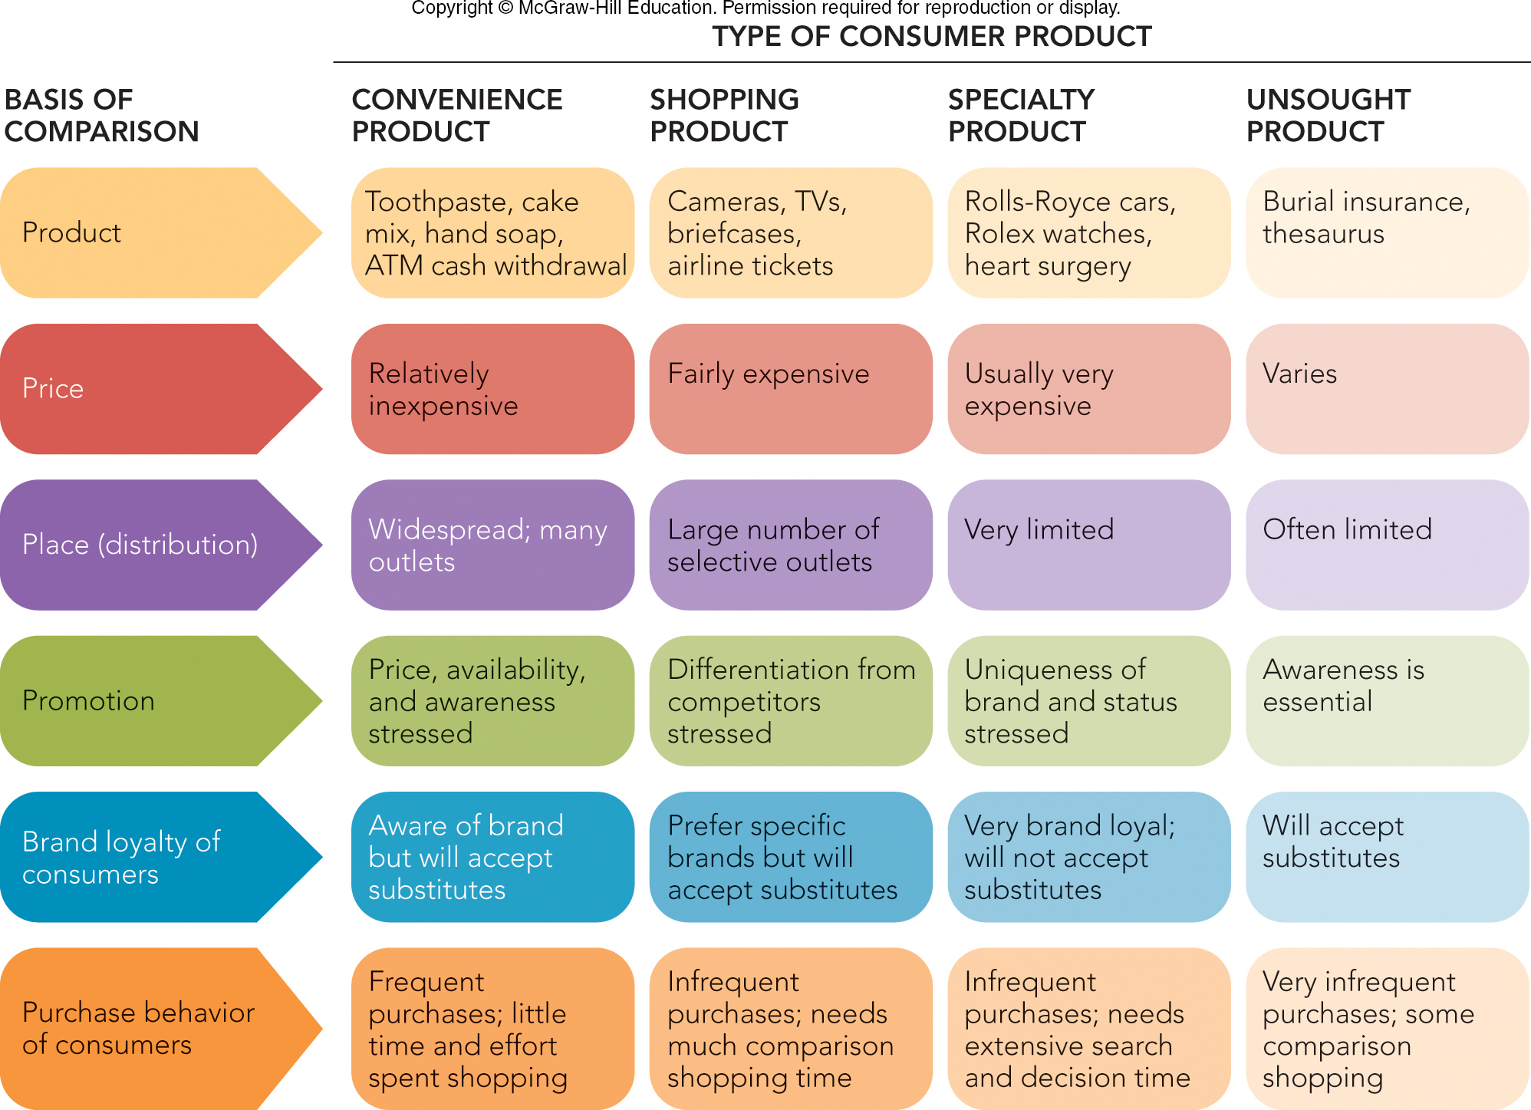
FIGURE 10-1 How a consumer product is classified affects which products consumers buy and the marketing strategies used.
Jump to Appendix 1 long image description

Slide 7
WHAT ARE PRODUCTS AND SERVICES? CLASSIFYING PRODUCTS (2 of 2)
Business Products
Derived Demand
Components
Support Products
Installations
Accessory Equipment
Supplies
Industrial Services

Slide 8
WHAT ARE PRODUCTS AND SERVICES? CLASSIFYING SERVICES
Delivery by:
People or Equipment
Business Firms or Nonprofit Organizations
Government Agencies

Slide 9
WHAT ARE PRODUCTS AND SERVICES? PRODUCT CLASSES, FORMS, ITEMS, LINES, AND MIXES (1 of 2)
Product Class (or Industry)
Different Product Forms Exist within the Product Class
Example: In the Recorded Music Industry There Are Records, Tapes, CDs, MP3s

Slide 10
WHAT ARE PRODUCTS AND SERVICES? PRODUCT CLASSES, FORMS, ITEMS, LINES, AND MIXES (2 of 2)
Product Item
Stock Keeping Unit (SKU)
Product Line
Product Mix

Slide 11

NEW PRODUCTS AND WHY THEY SUCCEED OR FAIL WHAT IS A NEW PRODUCT? (1 of 3)
Newness: Compared to Existing Products
Product Is New if Functionally Different from Existing Products
Revolutionary Newness Can Create New Industries (Example: Smartphones)
Xbox One
Video

Slide 12
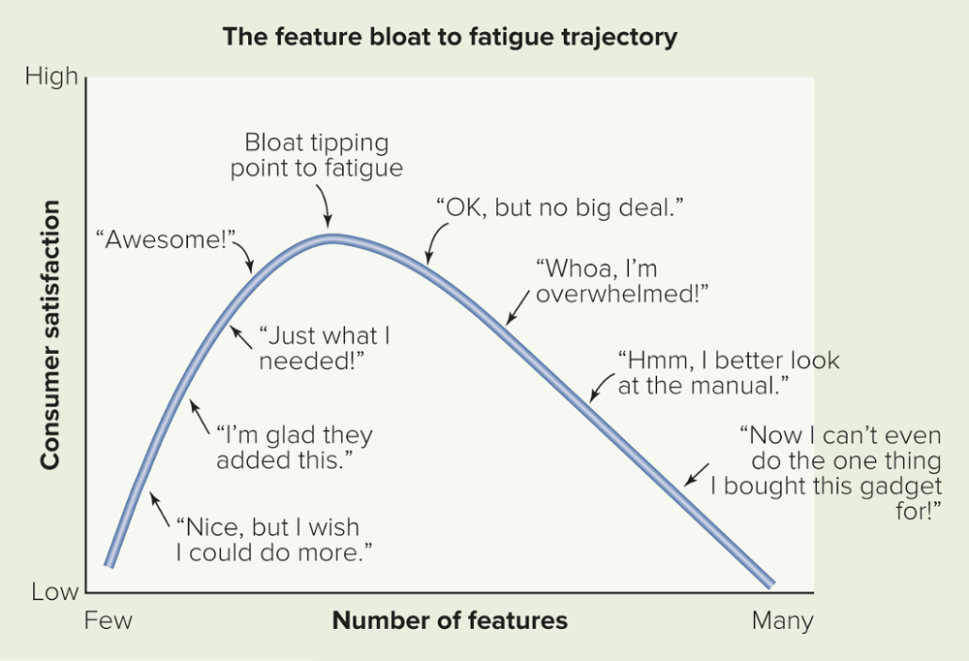
MARKETING MATTERS Too Much of a Good Thing: Feature Bloat and Fatigue in New-Product Development
Feature Bloat:
Unnecessary Features or Functions
Feature Fatigue:
Consumers Choose Overly Complex Products

Slide 13
NEW PRODUCTS AND WHY THEY SUCCEED OR FAIL WHAT IS A NEW PRODUCT? (2 of 3)
Newness: The Consumer’s Perspective
Continuous Innovation
Dynamically Continuous Innovation
Discontinuous Innovation

Slide 14
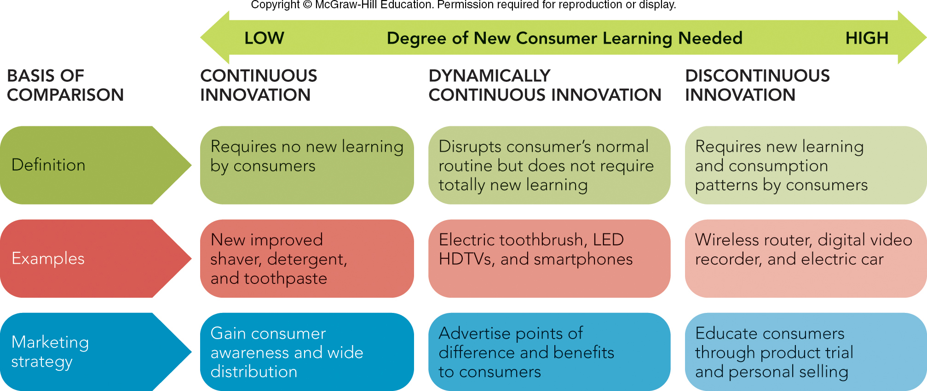
FIGURE 10-2 The degree of “newness” in a new product affects the amount of learning effort consumers exert to use the product.
Jump to Appendix 3 long image description

Slide 15
NEW PRODUCTS AND WHY THEY SUCCEED OR FAIL WHAT IS A NEW PRODUCT? (3 of 3)
Newness in Legal Terms
“New” Term Is Limited to 6 Months
Newness from the Organization’s Perspective
Product Line Extension
Jump in Innovation
Brand Extension

Slide 16
NEW PRODUCTS AND WHY THEY SUCCEED OR FAIL WHY PRODUCTS AND SERVICES SUCCEED OR FAIL (1 of 4)
Difficult to Produce a Successful New Product
Most Consumers Buy the Same 150 Items Consistently
Less than 3 Percent of New CPG Exceed Year 1 Sales of $50 Million

Slide 17
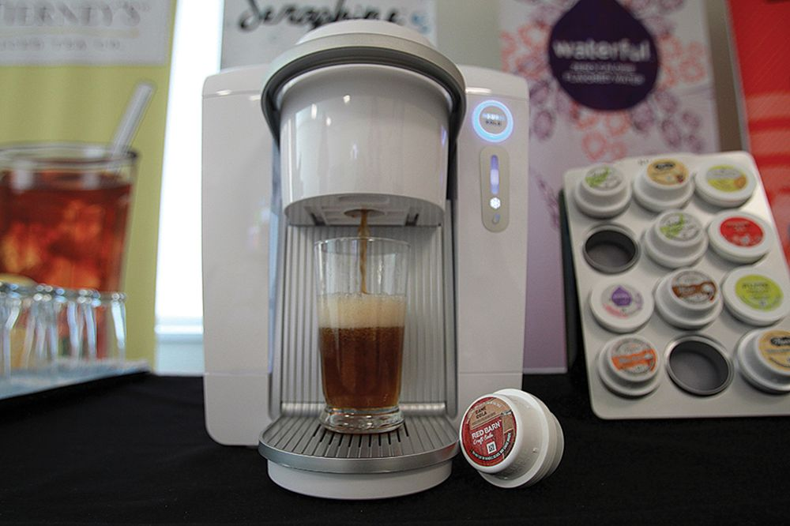
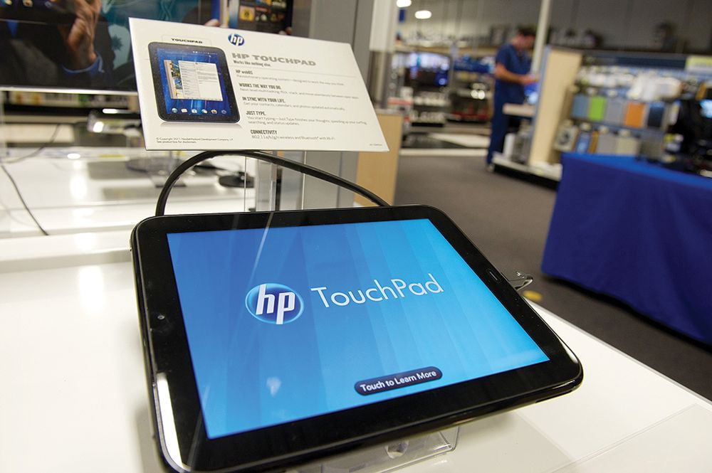
NEW PRODUCTS AND WHY THEY SUCCEED OR FAIL WHY PRODUCTS AND SERVICES SUCCEED OR FAIL (2 of 4)
Marketing Reasons for New-Product Failures
Insignificant Point of Difference
Incomplete Market and Product Protocol Before Product Development Starts
Not Satisfying Customer Needs on Critical Factors
Bad Timing
Left: ©David Paul Morris/Bloomberg via Getty Images; Right: ©Suzanne Kreiter/The Boston Globe via Getty Images

Slide 18
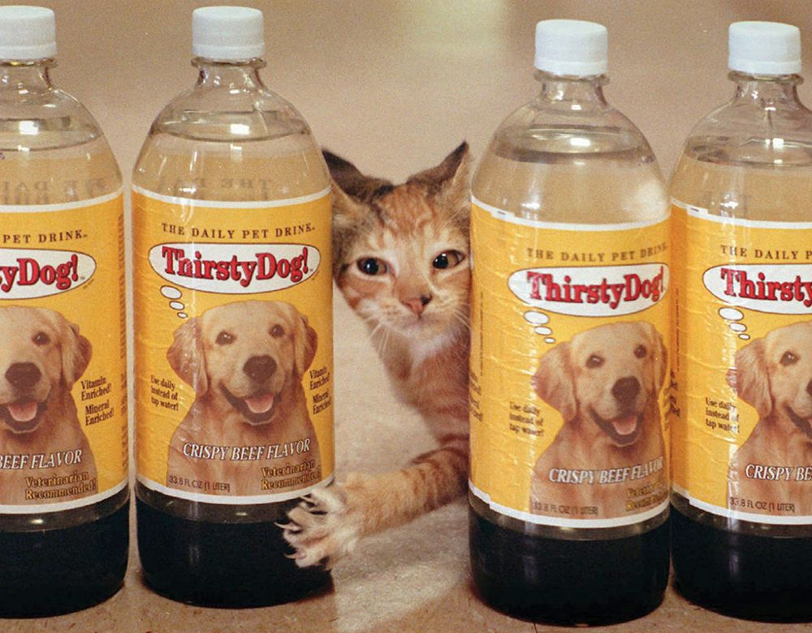
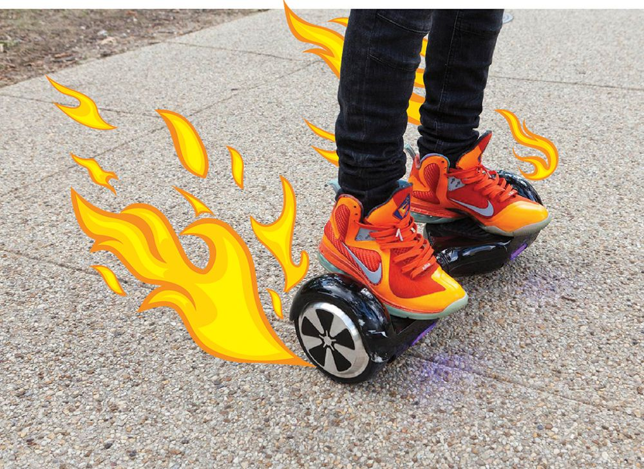
NEW PRODUCTS AND WHY THEY SUCCEED OR FAIL WHY PRODUCTS AND SERVICES SUCCEED OR FAIL (3 of 3)
Marketing Reasons for New-Product Failures (continued)
No Economical Access to Buyers
Poor Execution of the Marketing Mix
Too Little Market Attractiveness
Poor Product Quality
Left: ©B Christopher/Alamy Stock Photo; Right: ©Patrick Farrell/KRT/Newscom

Slide 19
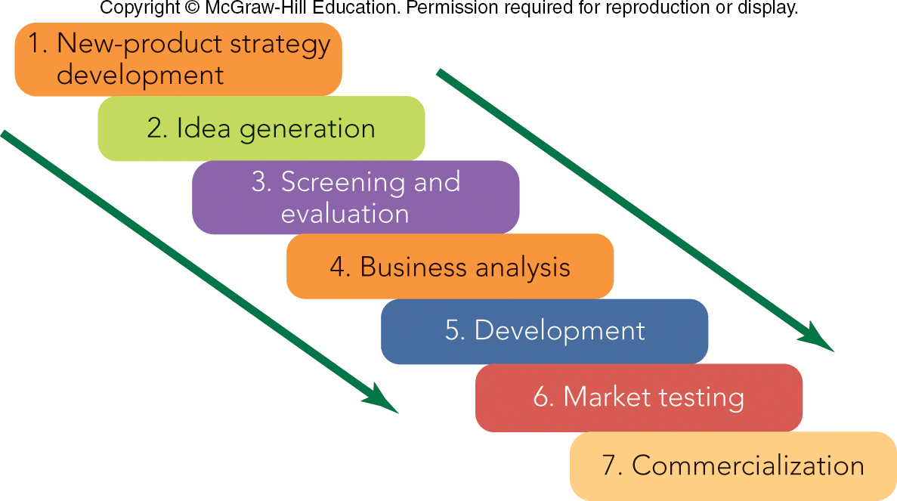
FIGURE 10-3 Seven stages in the new-product process leading to success

Slide 20
THE NEW-PRODUCT PROCESS STAGE 1: NEW-PRODUCT STRATEGY DEVELOPMENT
New-Product Strategy Development
SWOT Analysis
Environmental Scanning
Protocol and Strategic Role Defined
Disruptive Innovation Can Occur
Service Development Difficult

Slide 21

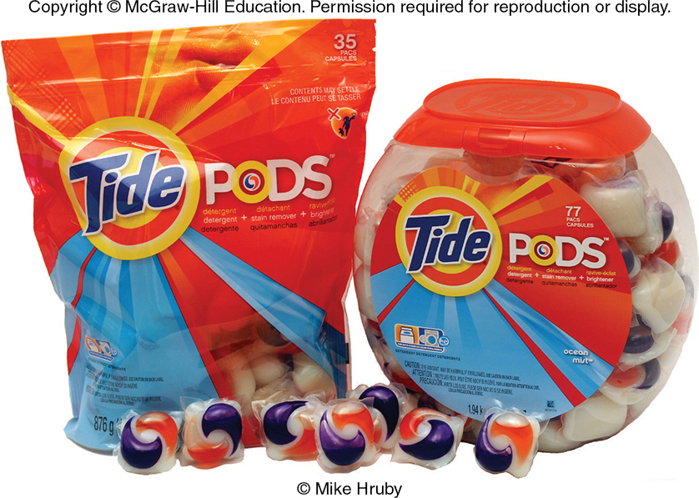
THE NEW-PRODUCT PROCESS STAGE 2: IDEA GENERATION (1 of 3)
Idea Generation
Open Innovation
Employee and Co-Worker Suggestions
Customer and Supplier Suggestions
Crowdsourcing
Life Is Good
Tide Pods Ad
Top: ©Michael Dwyer/AP Images; Bottom: ©McGraw-Hill Education/Mike Hruby, photographer

Slide 22
THE NEW-PRODUCT PROCESS STAGE 3: SCREENING AND EVALUATION
Screening and Evaluation
Internal Approach
Customer Experience Management (CEM)
External Approach
Concept Tests

Slide 23
THE NEW-PRODUCT PROCESS STAGE 4: BUSINESS ANALYSIS
Business Analysis
Prototype – Full-Scale Model
Business Fit of New Product
Financial Projections

Slide 24
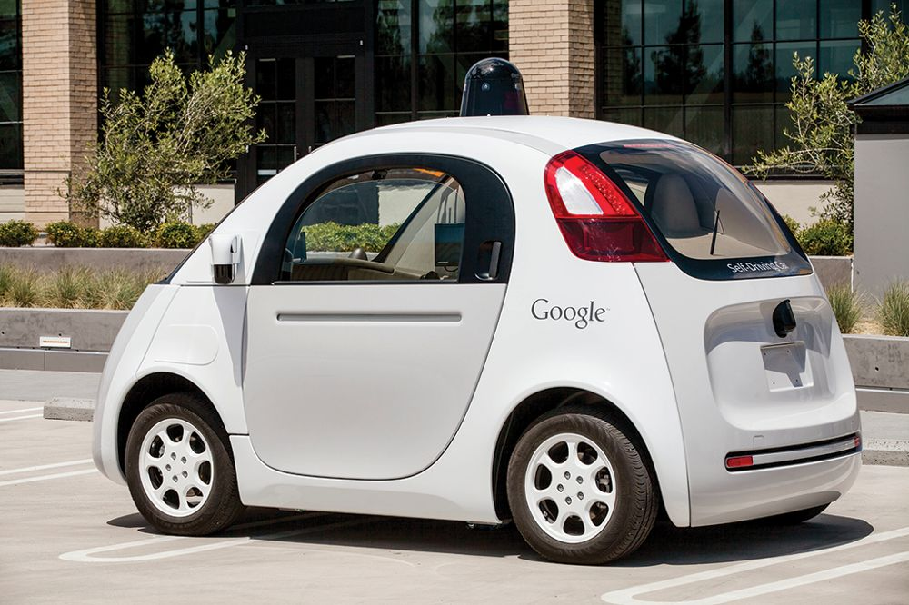
THE NEW-PRODUCT PROCESS STAGE 5: DEVELOPMENT
Development
Turns Ideas into Prototypes
Results in Demonstrable Product
Lab and Consumer Tests
Example: Google Driverless Car
©Kim Kulish/Corbis via Getty Images

Slide 25
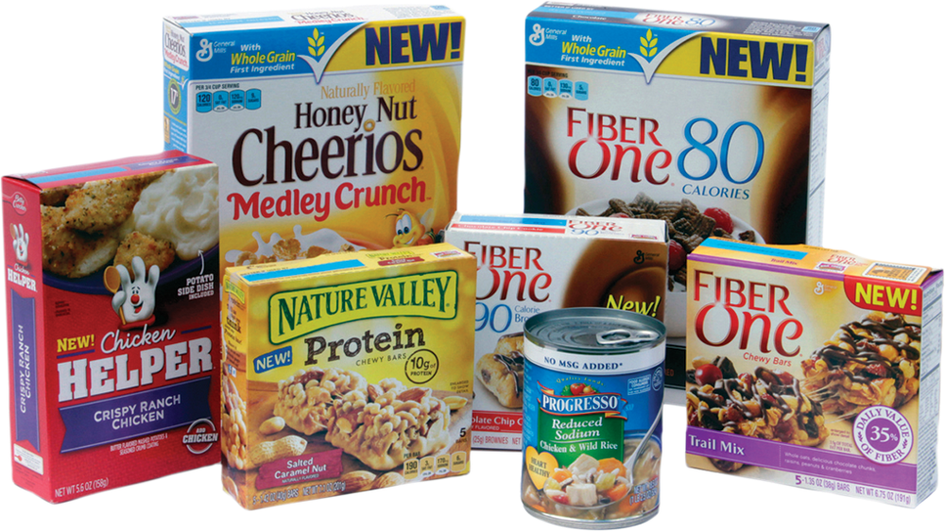
THE NEW-PRODUCT PROCESS STAGE 6: MARKET TESTING
Market Testing
Standard Test Markets
Controlled Test Markets, “Beta” launch
When Test Markets Don’t Work
Use Mock-ups or Prototypes
Courtesy of Bolin Marketing

Slide 26
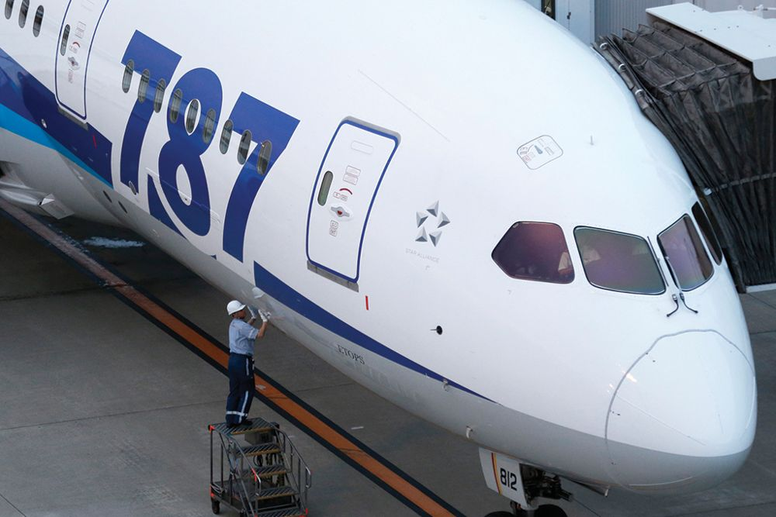
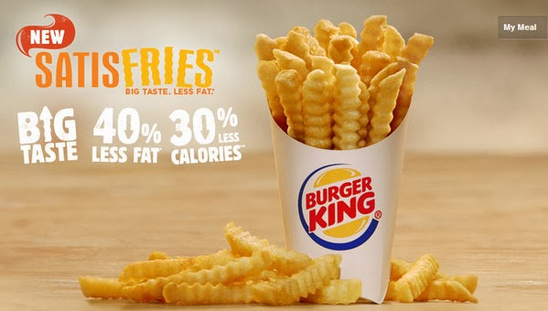
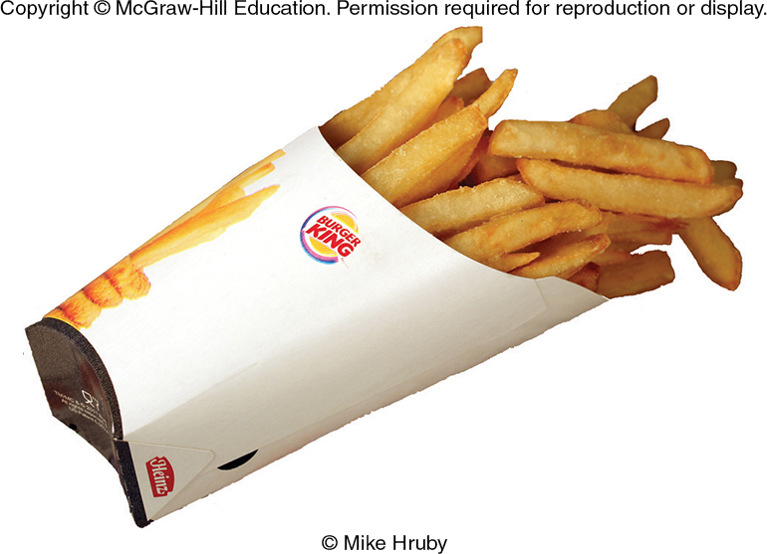
THE NEW-PRODUCT PROCESS STAGE 7: COMMERCIALIZATION
Commercialization
The Boeing 787 Dreamliner Experience
Technical Problems
Burger King French Fries: The Complexity of Commercialization- “Satisfries”
Too Complicated to Get Right,
“2” fryers slowed service
Top: ©KiyoshiOta/Bloomberg via Getty Images; Bottom: ©McGraw-Hill Education/Mike Hruby, photographer

Slide 27
The Rady School of Management
New Products & Services Development
Mid-Term Review
February 10, 2020
MGT 103

Slide 28

MARKETING MATTERS Was the Google Glass Half Full or Half Empty?
Augmented Reality Glasses:
Prototypes Sold to 8,000 Qualified “Glass Explorers” for $1,500 (2013)
Incomplete Product Testing
“Glassholes”
Withdrawn from Market (2015)
New Version – Glass Enterprise Edition – Being Tested for use by Workers
©Rex Features/AP Images

